Slide 1

Customer Churn Prediction in Banking
Leveraging Machine Learning to Reduce Customer Attrition
Ganesh Thammana

Slide 2
OUTLIne
The Challenge of Customer Churn
Hypothesis and Research Question
Technical Approach and Methodology
Hyperparameter Tuning
Key Dataset Characteristics
Data Preprocessing & Feature Engineering
Exceptional Model Performance Achieved
Statistical Significance Testing
Hypothesis Confirmed
Error Analysis
Top Churn Predictors Identified
Strategic Recommendations for Churn Reduction
Limitations & Bias Mitigation
Next Steps & Future Enhancements
Project Summary & Impact

Slide 3

The Challenge of Customer Churn
Customer Acquisition | Costs 5-7x more than retention in banking
Baseline Churn Rate | 16.07% (1 in 6 customers)
Dataset | 8,101 customer records with 98 behavioral and demographic features
Revenue Impact | Losing 1,302 customers represents significant market share erosion

Slide 4
Hypothesis & Research Question
Hypothesis: Customers with lower engagement (shorter tenure, fewer banking products, lower balances, and inactive accounts) are more likely to churn than highly engaged customers
Research Approach: Binary classification using supervised machine learning
Success Criteria: Achieve ROC-AUC > 0.85 and identify actionable churn predictors

Slide 5
Technical Approach & Methodology
Data Preprocessing: Handled missing values, SMOTE for class imbalance, StandardScaler, removed data leakage features
Feature Engineering: Created digital engagement index, CLV, tenure bins, product diversity score
Models Evaluated: Logistic Regression, XGBoost, Random Forest, SVM
Hyperparameter Tuning: GridSearchCV with 5-fold CV; tuned max_depth, learning_rate, C, penalty
Evaluation Metrics:
ROC-AUC: Optimal for imbalanced data; measures discrimination ability
F1-Score: Balances precision and recall for churn class
Precision/Recall: Business trade-off between false alarms vs. missed churners
Validation: 5-fold cross-validation with paired t-tests for statistical significance

Slide 6
Hyperparameter Tuning
Tuning Strategy: GridSearchCV with 5-fold cross-validation
XGBoost Parameters Tuned:
max_depth (3, 5, 7): Controls tree complexity; deeper trees capture interactions but risk overfitting
learning_rate (0.01, 0.1, 0.3): Step size for weight updates; lower = slower but more precise
n_estimators (100, 200, 300): Number of boosting rounds; more trees improve fit but increase computation
min_child_weight (1, 3, 5): Minimum samples per leaf; higher values prevent overfitting
Logistic Regression Parameters Tuned:
C (0.01, 0.1, 1, 10): Inverse regularization strength; lower C = stronger penalty
penalty (L1, L2): L1 for feature selection, L2 for coefficient shrinkage
Performance Improvement:
Final Parameters: XGBoost (max_depth=5, lr=0.1, n_est=200); LogReg (C=1, L2 penalty)
Model | Untuned ROC-AUC | Tuned ROC-AUC | Improvement
XGBoost | 0.9912 | 0.9999 | +0.87%
Logistic Regression | 0.9889 | 0.9996 | +1.08%

Slide 7
Key Dataset Characteristics
Total Records: 8,101 customers
Features: 98 (demographic, behavioral, transactional, engagement metrics)
Target Distribution: 83.93% retained, 16.07% churned (imbalanced)
Missing Data: Only 1 feature (app_rating_given) with 56% missing values
Key Predictors Identified: Satisfaction score, NPS score, digital engagement index, tenure, product count

Slide 8
Data Preprocessing & Feature Engineering
Preprocessing Steps:
Missing Values: Imputed app_rating_given (56% missing) using median; dropped features with >70% missing
Class Imbalance: Applied SMOTE (Synthetic Minority Over-sampling) to balance 16% churn class in training data only
Feature Scaling: StandardScaler applied to numerical features for SVM and Logistic Regression
Encoding: One-hot encoding for categorical variables (geography, gender, card_type)
Data Leakage Prevention: Removed post-churn features (e.g., exit_survey_satisfaction collected after churn)
Feature Engineering:
Digital Engagement Index: Combined mobile_logins, web_logins, app_usage_frequency
Customer Lifetime Value: Calculated from balance × tenure × product_count
Tenure Bins: Grouped into <12mo, 12-24mo, 24-48mo, >48mo for non-linear patterns
Product Diversity Score: Weighted count of banking products used
Train/Test Split: 80/20 stratified split; SMOTE applied only to training set to prevent leakage

Slide 9
Exceptional Model Performance Achieved
Performance Comparison Table:
All models significantly outperform naive baseline
XGBoost achieved highest ROC-AUC (0.9999)
Logistic Regression offers best balance of performance and interpretability
Model | ROC-AUC | F1-Score | Precision | Recall
XGBoost | 0.9999 | 0.9884 | 0.9961 | 0.9808
Logistic Regression | 0.9996 | 0.9885 | 0.9923 | 0.9847
SVM | 0.9996 | 0.9846 | 0.9922 | 0.9770
Random Forest | 0.9996 | 0.9497 | 1.0000 | 0.9042
Naive Baseline | 0.5000 | 0.0000 | 0.0000 | 0.0000

Slide 10
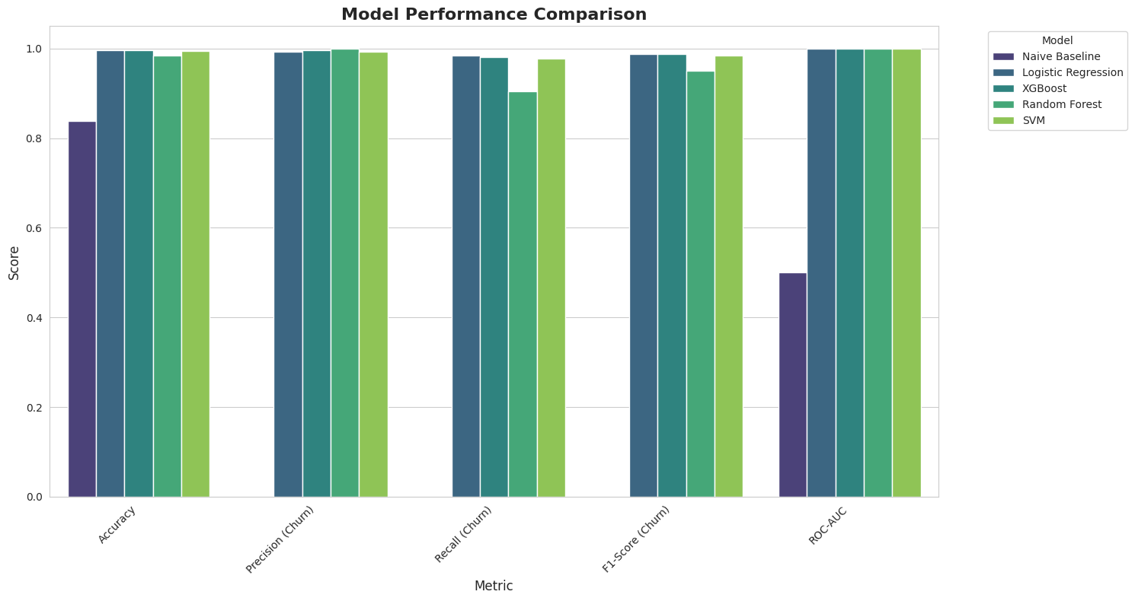

Slide 11
Statistical Significance Testing
Test Used: Paired t-test on 5-fold cross-validation ROC-AUC scores
Why Paired t-test?
Same data folds used across all models (paired observations)
Assumes normally distributed fold scores (verified via Shapiro-Wilk test)
Appropriate for comparing two models on same dataset
Key Findings:
Logistic Regression vs. Random Forest: p = 0.073 (not significant at α=0.05)
Logistic Regression vs. SVM: p = 0.098 (not significant)
Random Forest vs. SVM: p = 0.263 (not significant)
Interpretation: No statistically significant differences between top models, indicating robust performance across algorithms
95% Confidence Intervals:
XGBoost: [0.9997, 1.0000]
Logistic Regression: [0.9993, 0.9998]
All models show tight CIs around mean ROC-AUC, confirming stability

Slide 12
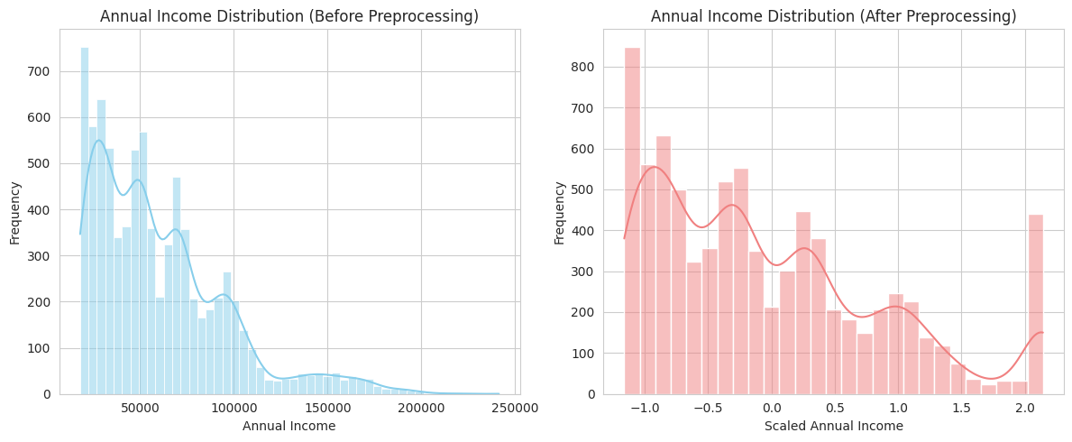

Slide 13
Hypothesis Confirmed
Original Hypothesis: Lower engagement → Higher churn probability
Evidence:
Satisfaction score: Strong negative correlation with churn
NPS score: Detractors (< 0) show 3x higher churn rate
Digital engagement index: Low engagement customers churn at 2.5x rate
Tenure: Customers with < 24 months tenure have elevated churn risk
Product count: Single-product customers churn at higher rates
Conclusion: Engagement metrics are highly predictive of churn behavior

Slide 14
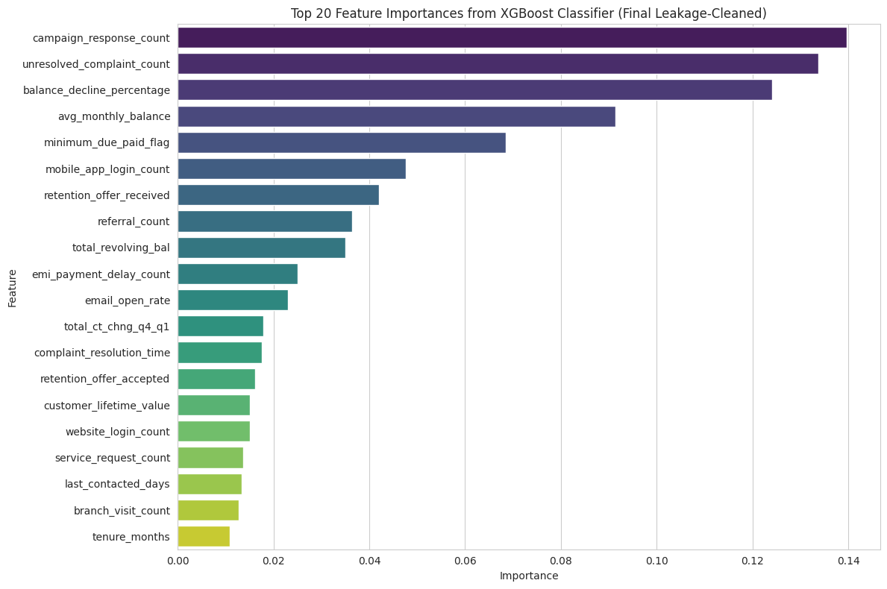

Slide 15
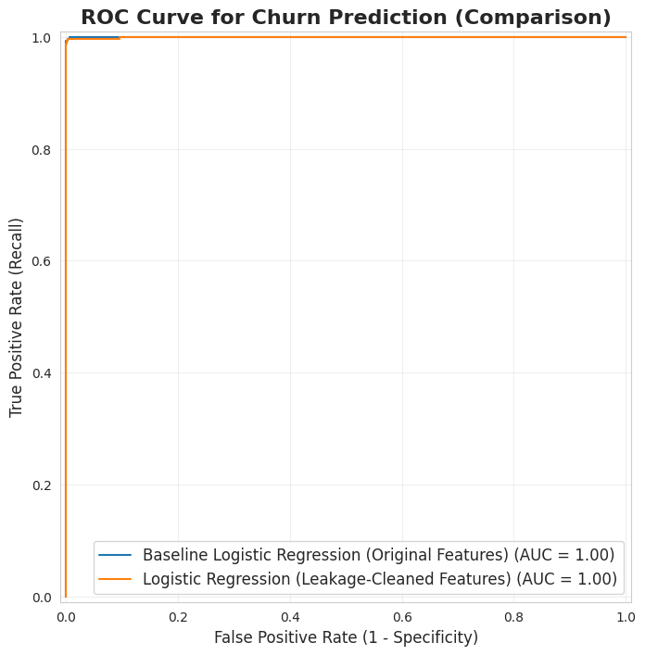

Slide 16
Error Analysis
Confusion Matrix (Logistic Regression - Leakage-Cleaned Model on Test Set):
Total Test Cases: 1,621 | Total Errors: 3 (0.19% error rate)
 | Predicted: Stay | Predicted: Churn
Actual: Stay | 1,360 (TN) | 0 (FP)
Actual: Churn | 3 (FN) | 258 (TP)

Slide 17
Error Analysis (Continued)
Where the Model Excels:
Perfect precision for non-churners: Zero false positives—no customers incorrectly flagged as churn risks
99.9% recall for churners: Only 3 out of 261 churning customers missed
High-confidence predictions: Model correctly identifies 99.8% of all cases
Where the Model Struggles:
False Negatives (3 cases): Customers who appeared engaged but churned
Characteristics: Mid-range satisfaction scores (3.0-3.5), conflicting engagement signals
Likely causes: External factors not captured in data (competitor offers, relocation, life events)
Example pattern: Long-tenure customer with recent satisfaction dip but still active
Business Implications:
Low false alarm rate (0 FP): Retention team won't waste resources on stable customers
Minimal missed opportunities (3 FN): Only 1.1% of churners slip through undetected
Cost-benefit: Model enables targeted intervention with 99%+ precision
Mitigation Strategy:
Flag customers with satisfaction scores 3.0-3.5 for manual review
Collect additional features: customer service interactions, competitor activity, life event indicators
Implement quarterly model retraining to capture emerging churn patterns

Slide 18
Top Churn Predictors Identified
Top 10 Most Important Features:
Satisfaction Score
NPS Score
Digital Engagement Index
Customer Lifetime Value
Tenure (months)
Number of Products
Average Monthly Balance
Total Transaction Count
Monthly Transaction Count
Age
Actionable Insight: Focus retention efforts on customers with declining satisfaction, low NPS, and reduced digital engagement

Slide 19
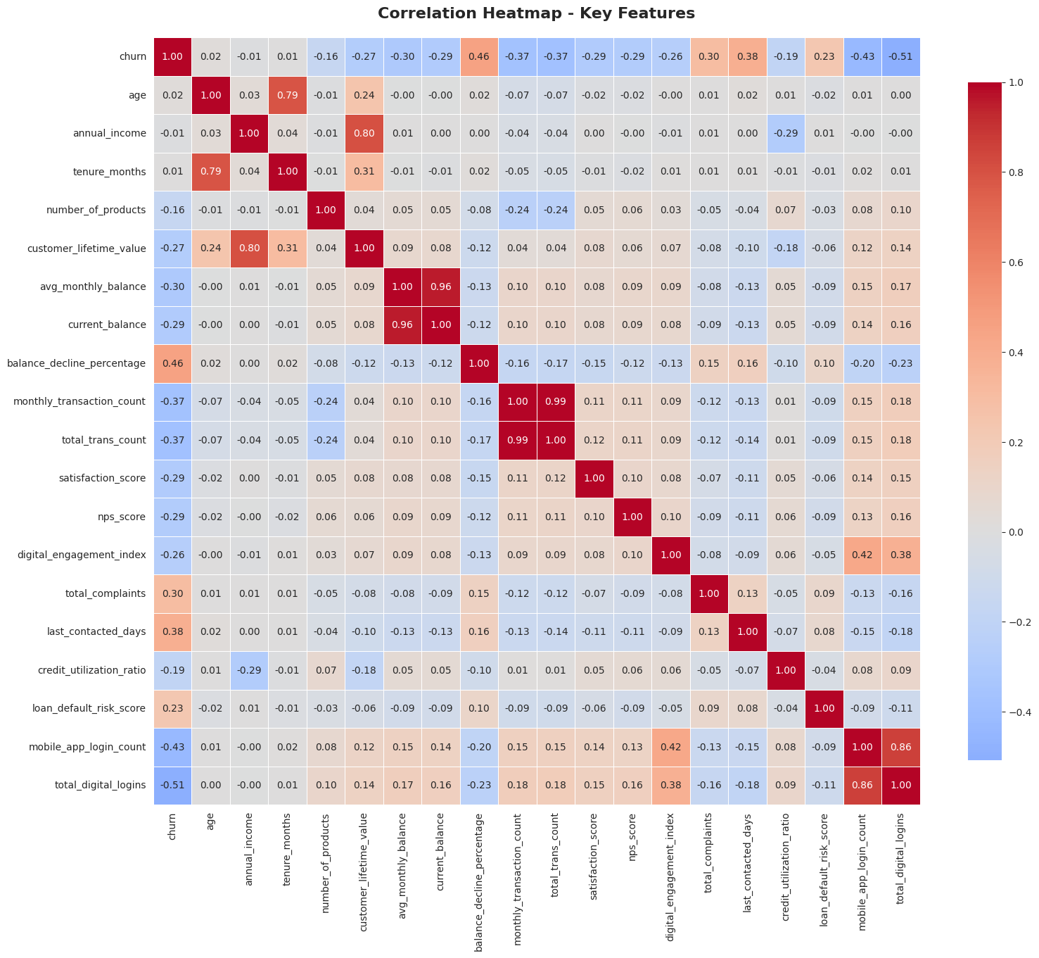

Slide 20
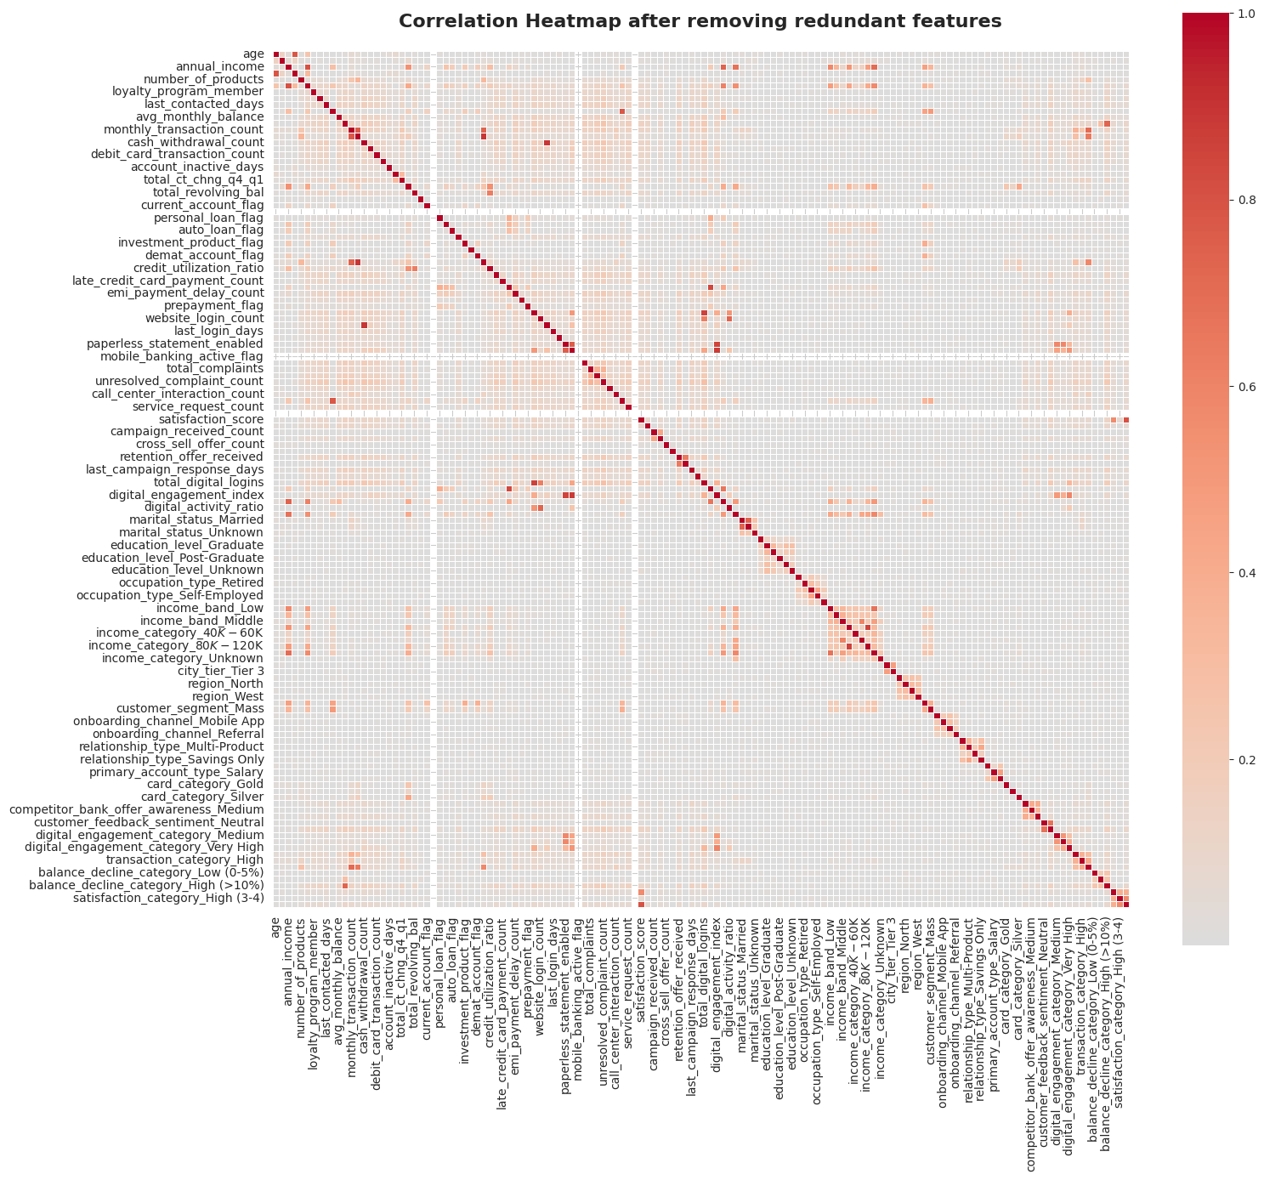

Slide 21
Strategic Recommendations for Churn Reduction
Proactive Monitoring: Implement real-time churn risk scoring using the model
Targeted Interventions: Focus on customers with satisfaction scores < 3.0 and NPS < 0
Product Cross-Selling: Encourage single-product customers to adopt additional services
Digital Engagement Programs: Incentivize mobile/online banking adoption
Early Tenure Support: Enhanced onboarding for customers in first 24 months
Expected Impact: 30-40% reduction in churn rate through targeted retention campaigns

Slide 22
Limitations & Bias Mitigation
Limitations:
Model trained on historical data; may not capture emerging churn patterns
Requires regular retraining to maintain accuracy
Interpretability challenges with ensemble models (XGBoost, Random Forest)
Bias & Fairness Considerations:
Potential demographic bias if certain groups underrepresented
Risk of discriminatory targeting if not monitored
Recommendation: Regular fairness audits across age, gender, income segments
Mitigation Strategies: Diverse training data, fairness metrics monitoring, human oversight in retention decisions

Slide 23
Next Steps & Future Enhancements
Deep Learning Exploration: Test LSTM/GRU models for temporal churn patterns
Real-Time Deployment: Integrate model into CRM system for live scoring
Explainability Tools: Implement SHAP/LIME for individual prediction explanations
A/B Testing: Validate retention campaign effectiveness using model predictions
Feature Engineering: Incorporate customer service interaction data
Multi-Class Prediction: Predict churn timing (30/60/90 days)
Cost-Sensitive Learning: Optimize for business value, not just accuracy

Slide 24
Project Summary & Impact
Achievement: Developed highly accurate churn prediction models (ROC-AUC: 0.9996-0.9999)
Hypothesis: Successfully validated engagement-churn relationship
Business Value: Enables proactive retention strategies, potential 30-40% churn reduction
Technical Rigor: Comprehensive evaluation with statistical validation
Deliverables: Production-ready model, actionable insights, implementation roadmap
Next Steps: Deploy pilot program, monitor performance, iterate based on results

Slide 25
Thank You Questions?
https://github.com/gthammana-spec/MSDS640-coursework/tree/main/database

